Slide 1







Technology Trends and Analysis
DIKSHA SAPRA
5th May, 2023

Slide 2



OUTLINE
Executive Summary
Introduction
Methodology
Results
Visualization – Charts
Dashboard
Discussion
Findings & Implications
Conclusion
Appendix

Slide 3

EXECUTIVE SUMMARY
Trends in programing languages and databases
Demographics Survey
Technological gap in countries
Gender gap in jobs

Slide 4

INTRODUCTION
About:
Analyzing trends in software development.
Purpose:
Identify skill requirements for future.
What are top programing languages in demand.
What are top databases skills in demand.
Audience: Human Resource and IT Head.

Slide 5

METHODOLOGY
Data Collection Sources
Stack Overflow Developer 2019 Survey
GitHub Job Postings
Programming Languages Annual Salary
Data Exploration
Data Cleaning
Data Visualization
Presentation

Slide 6
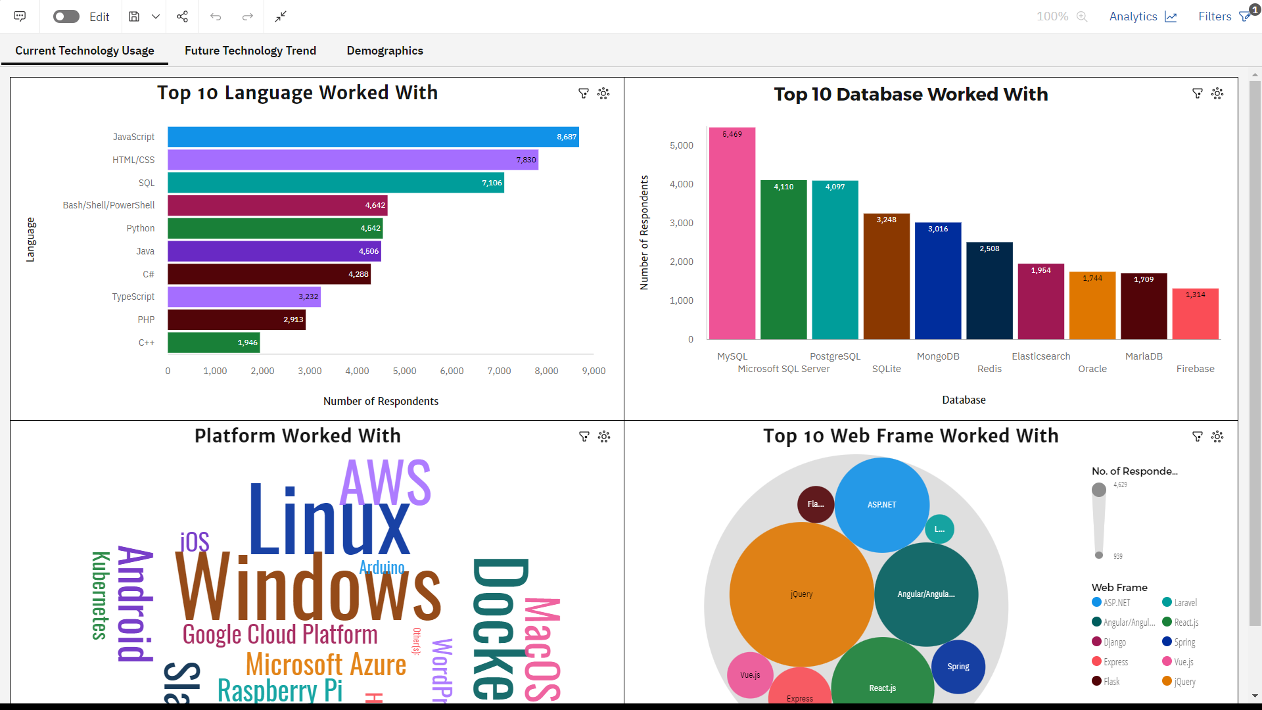
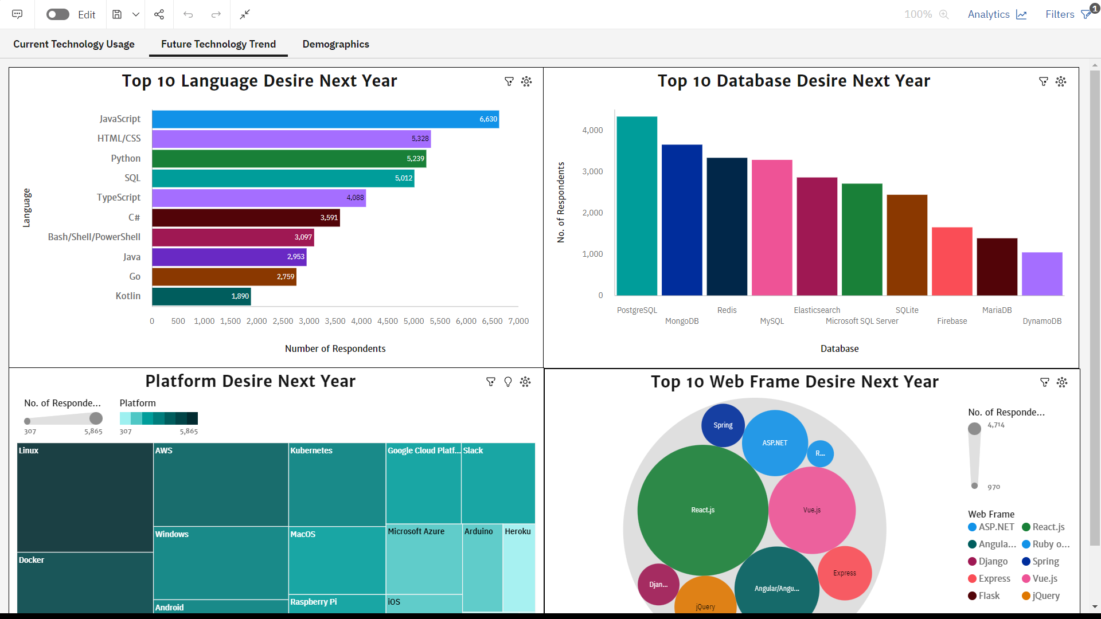
PROGRAMMING LANGUAGE TRENDS
Current Year
Next Year

Slide 7
PROGRAMMING LANGUAGE TRENDS - FINDINGS & IMPLICATIONS
Findings
Java, HTML/CSS, SQL are top 3 this year.
Python & Typescript are becoming popular in coming years.
C++ edged out in next year.
Implications
Web development still in high demand.
Big Data Tech companies require SQL.
Python is becoming the best choice in coming years.

Slide 8

DATABASE TRENDS
Current Year
Next Year

Slide 9
DATABASE TRENDS - FINDINGS & IMPLICATIONS
Findings
MySQL is most popular.
MongoDB and Redis are upcoming.
Oracle will get vanished by next year.
Implications
Open source databases are preferred.
Redis supports abstract data types.
NoSQL databases will make an impact for storing non relational data.

Slide 10

DASHBOARD
https://us3.ca.analytics.ibm.com/bi/?perspective=dashboard&pathRef=.my_folders%2FCapstone%2BProject%2FFinal%2BDashboard&action=view&mode=dashboard&subView=model000001888b4670b5_00000002

Slide 11
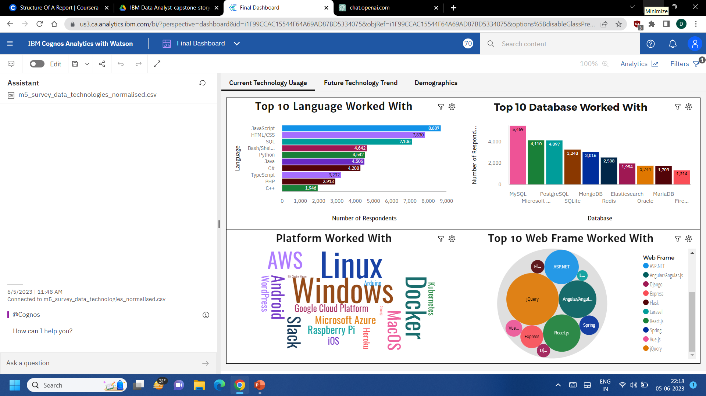
DASHBOARD TAB 1

Slide 12
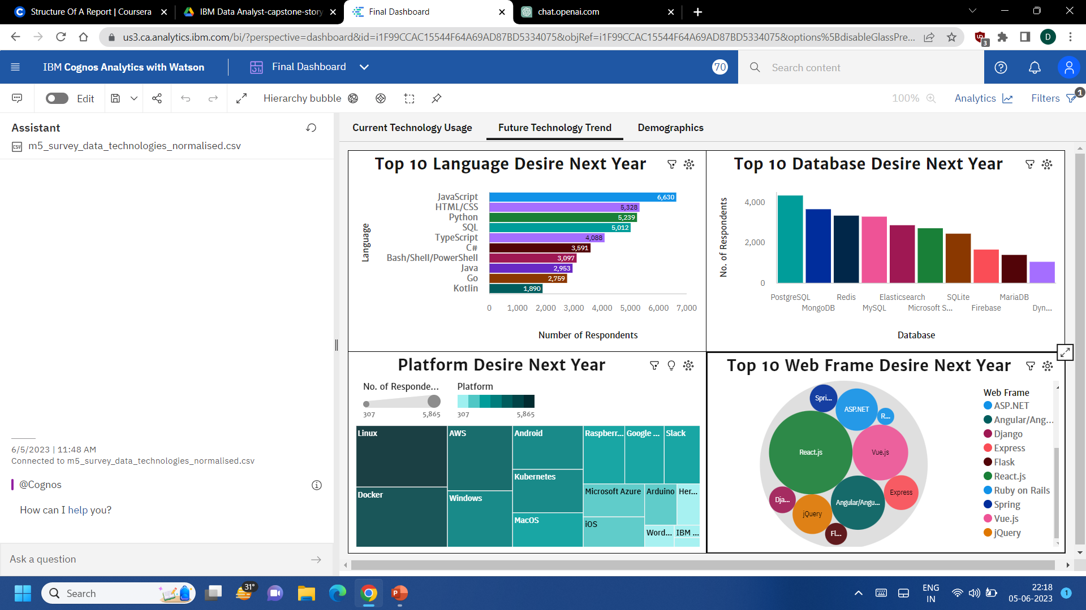
DASHBOARD TAB 2

Slide 13
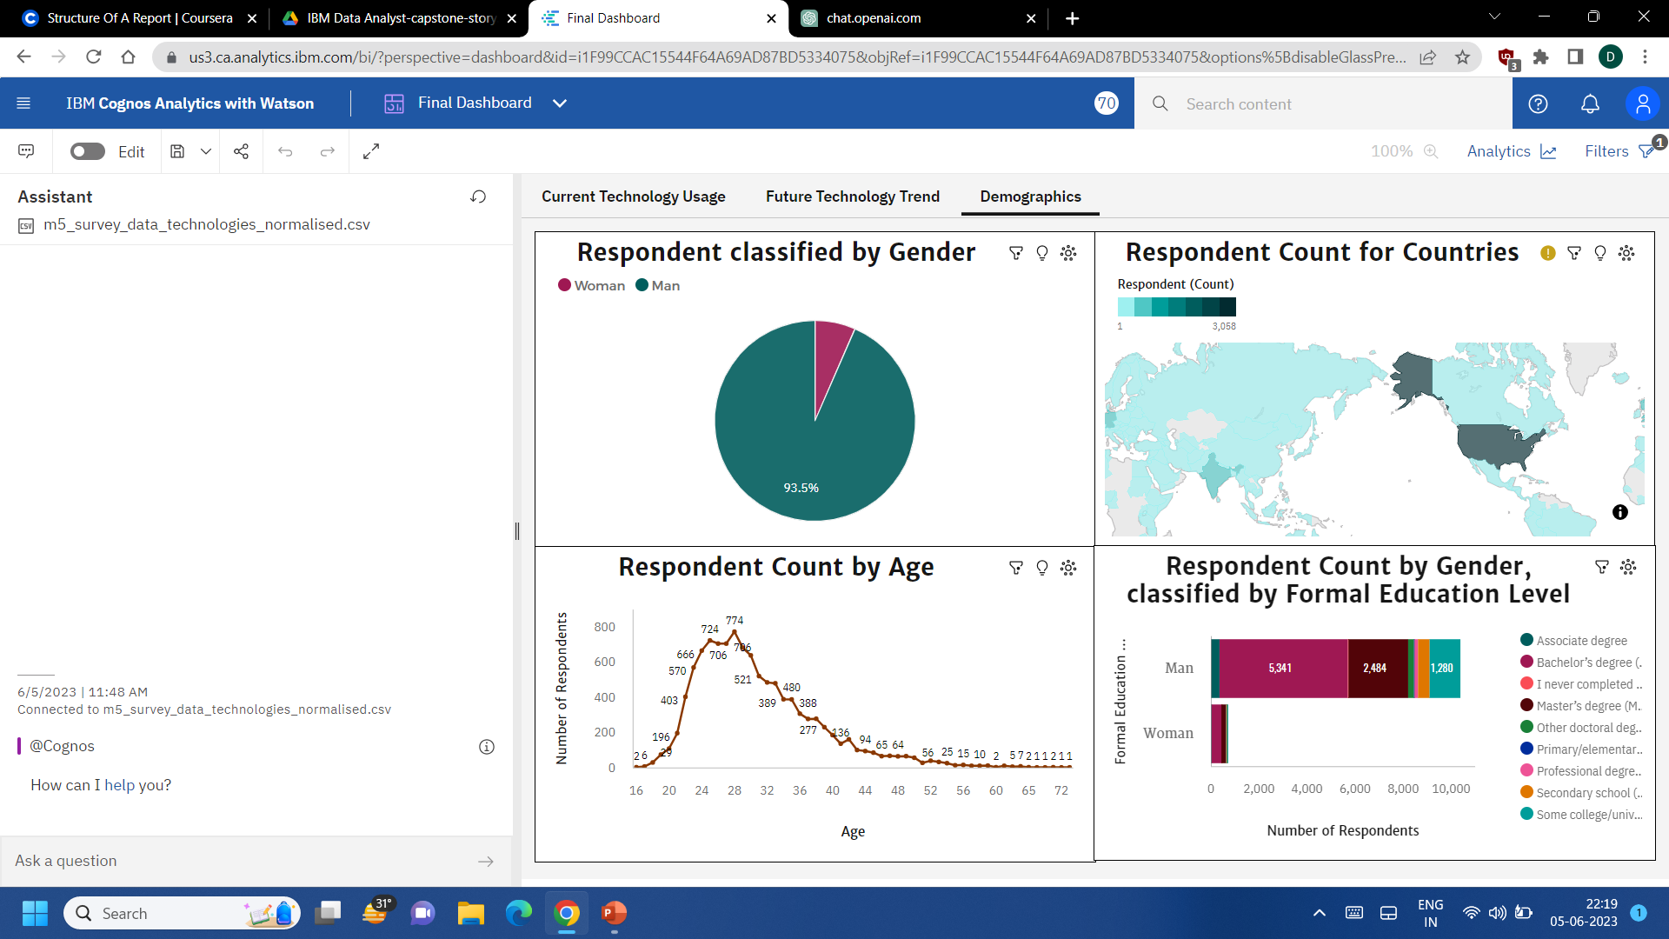
DASHBOARD TAB 3

Slide 14

CONCLUSION
Technology Trends now and future.
Training and reskilling workers.
Female participation in technology field.
Eliminate age , gender and education discrimination in employment.

Slide 15
JOB POSTINGS

Slide 16
POPULAR LANGUAGES

